Slide 1

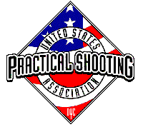
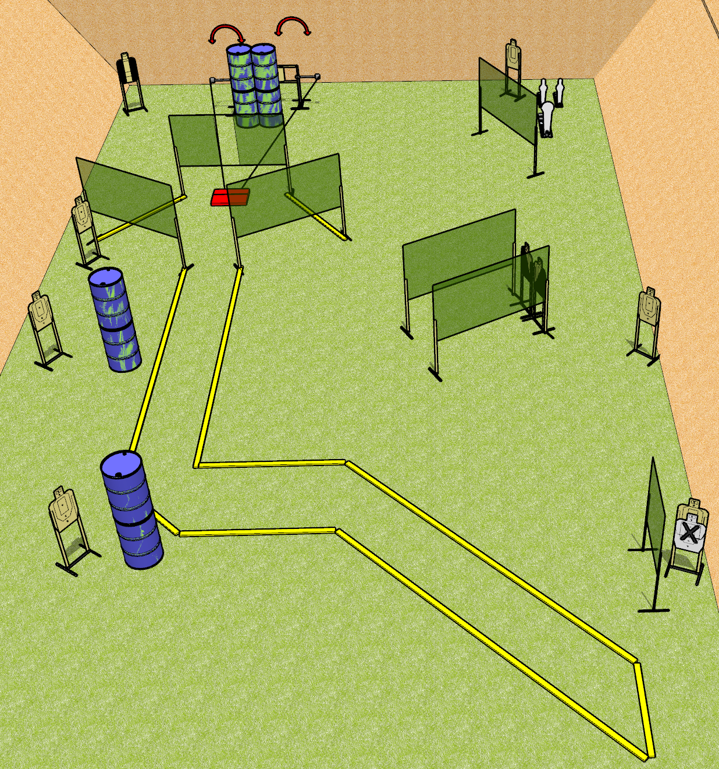
 | Dothan Gun Club – USPSA Match Not so Straight and Narrow Course Designer : Drew Coleman
Round Count 25 rounds 12 USPSA 2 mini poppers, 1 colt popper
Equipment List 2 medium fault lines 12 wall feet 2 swingers + stomp box

Slide 2
Not so Straight and Narrow
Written Stage Briefing
Not so Straight and Narrow is a 25 round, 125 point, Comstock course of fire. There are 12 USPSA targets, 2 mini poppers, and 1 colt popper. The best 2 hits on paper will score, and steel must fall to score. The start signal is audible.
The stomp box activates both swingers which remain visible at rest.
Handgun start position is inside shooting area, wrists below belt. Handgun is loaded and holstered.
PCC start position is inside shooting area, stock on belt. Carbine is loaded with safety on.
On start signal, engage targets as they become available from within the shooting area.

